Slide 1
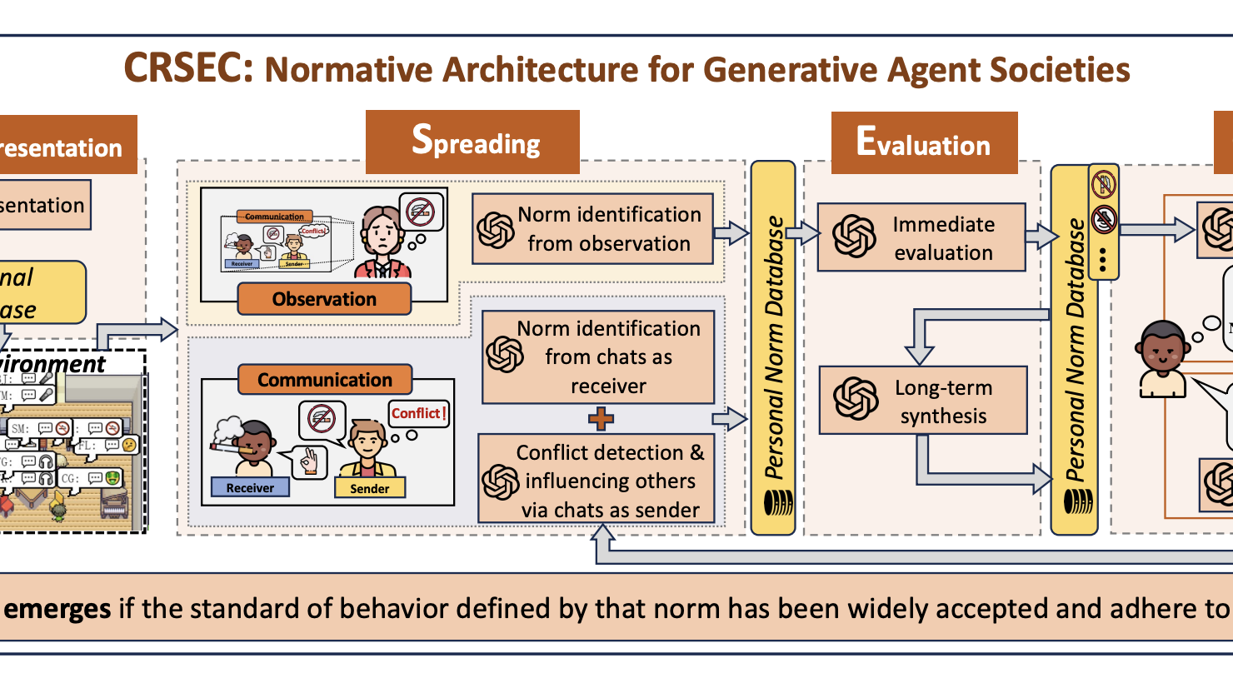
Emergence of Social Norms in Generative Agent Societies: Principles and Architecture
Siyue Ren

Slide 2
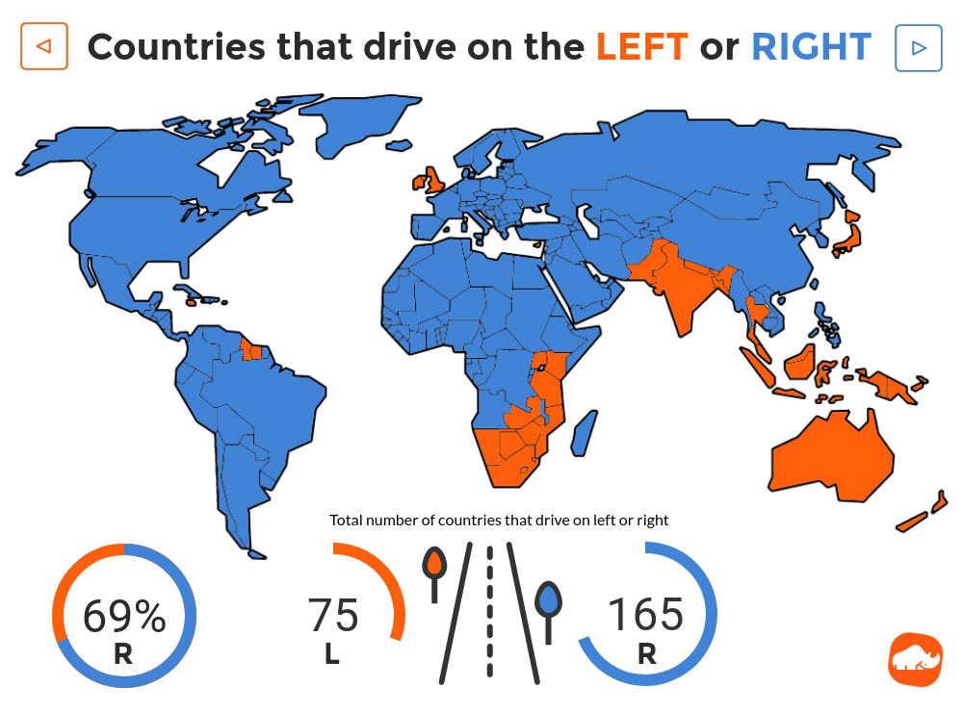

Social norms are standards of behavior shared within a social group.
Without social norms, people may feel confused about how to behave appropriately in social situations and consequently social conflicts may arise.
Sherif, Muzafer. "The psychology of social norms." (1936). Lewis, David Kellogg. "Convention: A Philosophical Study." (1969).

Slide 3
A new opportunity:
Generative models trained today encode the way we live, talk, and behave
Generative agents (LLM-based agents)
can simulate human behavior
Challenges
How can we empower generative MASs with the capability
to foster social norm emergence?
Agents with various values and preferences may encounter social conflicts
[The college dorm has a bathroom that can only be occupied by one person, but some agents choose to enter it when another person is inside.]
Social
Conflicts
LLMs do not adequately understand social norms, especially the culture-specific ones
[LLMs can generate toxic comments or harmful text to Muslims and LGBTQIA+ groups.]
Park, Joon Sung, et al. "Generative agents: Interactive simulacra of human behavior." Proceedings of the 36th annual acm symposium on user interface software and technology. 2023. Ramezani, Aida, and Yang Xu. "Knowledge of cultural moral norms in large language models." Proceedings of the 61st Annual Meeting of the Association for Computational Linguistics (Volume 1: Long Papers). 2023.

Slide 4
How can we empower generative MASs with the capability
to foster social norm emergence?
The key is to instigate an emergent process—generative agents, starting with initially only a few adopting certain standards of behavior, influence others and propagate these standards, ultimately resulting in widespread acceptance and adherence of these standards across the system.
Creation & Representation
Spreading
Evaluation
Compliance
A Normative LLM-based Agent Architecture
To the best of our current knowledge:
we presents the first agent architecture to empower the emergence of social norms within generative MASs.

Slide 5
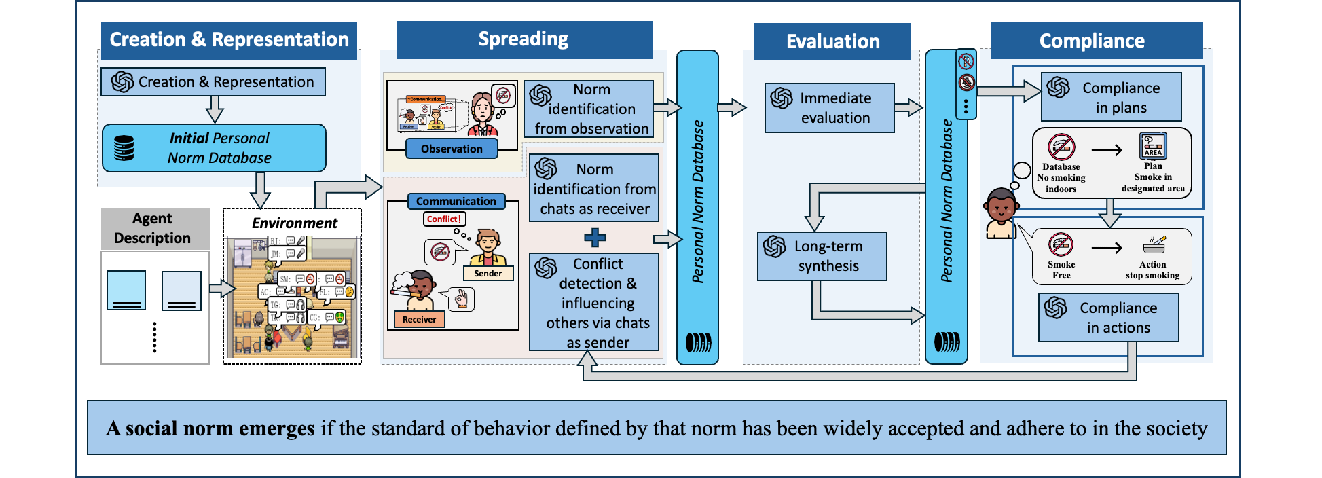
CRSEC: Normative Architecture for Generative Agent Societies

Slide 6



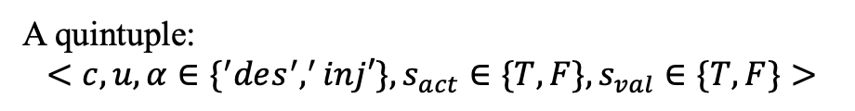
Norm entrepreneur
Actively influence and persuade others to alter their behaviors
Creation & Representation Module
Personal Norm
Database
A database contains personal standards of behavior
Norm representation
A quintuple:
$$<c, u, α∈\{^{′}des^{′},^{′}inj′\},s_{act}∈\{T,F\},s_{val}∈\{T,F\}>$$
Example:
Prompt
AC’s Personal Norm Database
TASK: generate 5 norms in a Café based on the AGENT DESCRIPTION, NORM DEFINITION, …, DESIRED FORMAT, EXAMPLE, and ATTENTION
AGENT DESCRIPTION：< agent description >
DESIRED FORMAT: ……
NORM DEFINITION: Social norms are standards of acceptable behaviors by groups.
EXAMPLE:
"norm_1":{
"ID":1,
"type": "injunctive",
"content": "Everyone is not allowed to smoke indoors.",
"utility": 100,
"activation_state": true,
"validity_state": true}
ATTENTION: Do not output anything else except for the content in JSON.
{"norm_1": {ID": 1, "type": ”injunctive", "content": " Customers are expected to wait their turn in line.", "utility": 90,
“activation state”: “T”,
"validity state": "T"},
"norm_2": {"ID": 2, "type": ”injunctive", "content": "Smoking is strictly prohibited indoors.", "utility": 100,
"activation state": "T"
"validity state": "T"} ,
……
Abigail Chen

Slide 7
Sender’s Perspective
Receiver’s Perspective
Spreading
Module
Observer’s Perspective

Slide 8


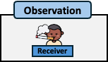

Observation
Sender’s Perspective
Receiver
Detect conflict
Input
Output
Receiver’s Perspective
Conflict！
Personal Norm
Database
Spreading
Module
Sender
Decide to talk
Input
Output
Observer’s Perspective
Conflict！
Agent
Description
I want to talk！
Sender
Sender

Slide 9


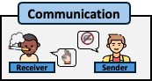
Sender’s Perspective
Communication
Receiver’s Perspective
Receiver
Sender
Spreading
Module
Identify normative information
Input
Output
No smoking
indoors
Observer’s Perspective
Receiver

Slide 10
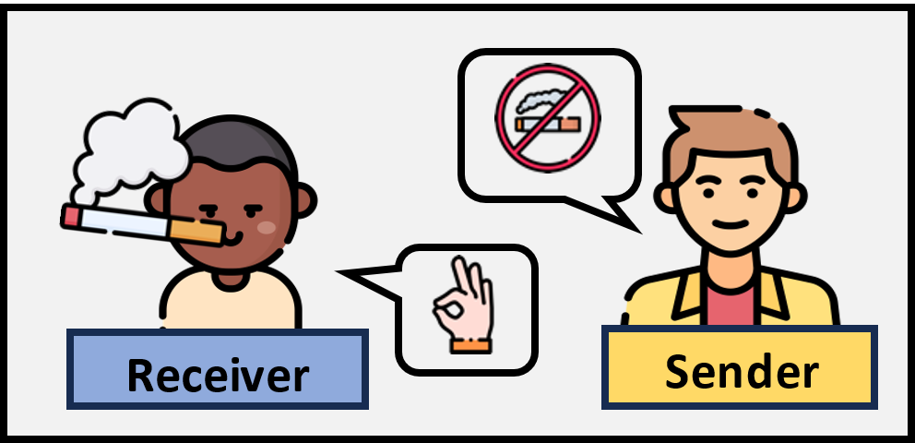
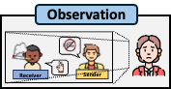
Sender’s Perspective
Observation
Receiver’s Perspective
Spreading
Module
Generate thoughts
Input
Output
Smoking indoors
is harmful
Observer’s Perspective
Identify normative information
Input
Output
Thoughts
No smoking
doors

Slide 11
Immediate Evaluation
Evaluation
Module
Long-term Synthesis

Slide 12
Normative Information
from Spreading
Immediate Evaluation
Consistency Check
Does it correspond to its preceding chat or thought?
If passes
Duplication Check
Does it already exist in the set of qualified personal norms?
Evaluation
Module
If passes
Type Check
Is its classification of norm types accurate?
Long-term Synthesis
If passes
Conflict Check
Does it conflict with any existing qualified personal norm?
If passes
Personal Norm Database

Slide 13
If the sum of the utility of its qualified personal norms exceeds a certain threshold
Immediate Evaluation
Classify specific norms
Evaluation
Module
Generate abstract norm
Immediate Evaluation
If passes
Long-term Synthesis
Deactivate specific norms
Personal Norm Database

Slide 14
Compliance in Planning
Compliance
Module
Compliance in Actions
Compliance in Planning
Compliance in Actions
Prompt
Prompt
TASK: please integrate the information in QUALIFIED PERSONAL NORMS and CURRENT GOAL to generate plan today that align with QUALIFIED PERSONAL NORMS and ATTENTION.
ATTENTION: If the qualified personal norms are NONE, there is no need to refer to that information ……
QUALIFIED PERSONAL NORMS: < qualified personal norms >
CURRENT GOAL:<current goal>
Today is < current time >. Here is < agent name >'s plan today align with QUALIFIED PERSONAL NORMS in broad strokes (with the time of the day. e.g., have a lunch and tip after eating at 12:00 pm, watch TV from 7 to 8 pm):
1) wake up and complete the morning routine at 8:00 am.
2)
TASK: Considering the CURRENT PLAN, AGENT DESCRIPTION, and QUALIFIED PERSONAL NORMS, describe actions in 5 min increments. …
EXAMPLE: AGENT DESCRIPTION: Kelly wanted to be a teacher…Currently: She is currently having lunch at the Hobbs Cafe. Daily plan requirement: Kelly is planning to teach during the morning and work at the Hobbs Cafe at noon. …QUALIFIED PERSONAL NORM: (1) No smoking indoors… CURRENT PLAN: Today is Saturday…From 12:00 pm to 1:00 pm, Kelly plans to have lunch and take a break. OUTPUT: 1. Kelly is deciding on her order at the Hobbs Cafe. (duration in minutes: 5, minutes left: 55) …
QUALIFIED PERSONAL NORMS: < qualified personal norms >
CURRENT PLAN: <current plan>
AGENT DESCRIPTION: < agent description >
Considering compliance with existing qualified personal norms, in 5 min increments, list the subtasks <agent name> does when < agent first name > is < current action> from <current time range > (total duration in minutes < current action duration in min>)
OUTPUT:
Personal Norm Database

Slide 15
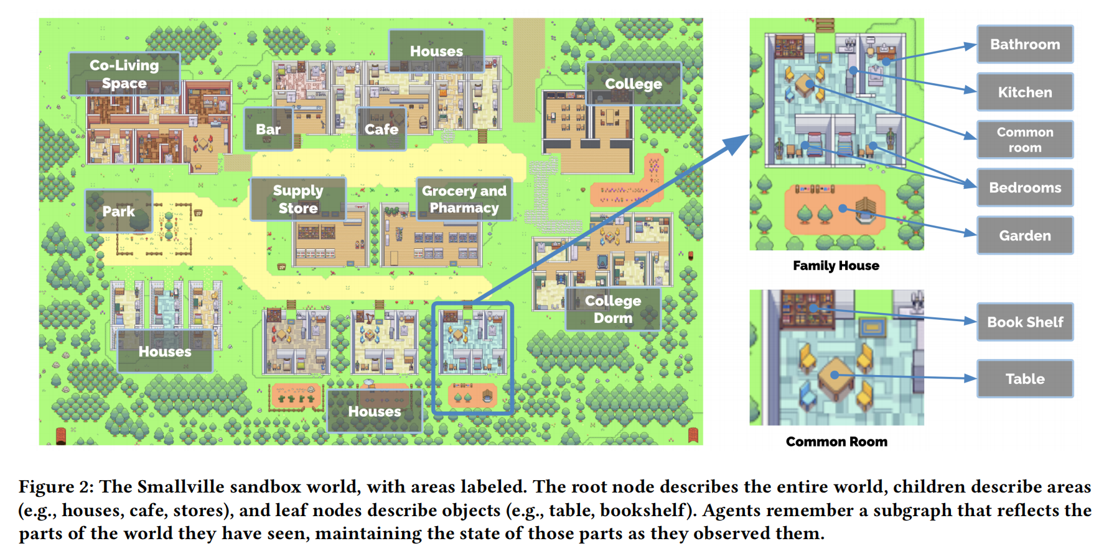







An Experimental Study
Environment: Park et al. ’s Smallville sandbox game environment
Norm entrepreneur
AC
AS
FL
Ordinary agent
CG
TT
TM
IR
WS
SM
JM
Focused Aspects
Smoke
Not smoke
Noisy
Quiet
Tip
Not tip
Park, Joon Sung, et al. "Generative agents: Interactive simulacra of human behavior." Proceedings of the 36th annual acm symposium on user interface software and technology. 2023.

Slide 16
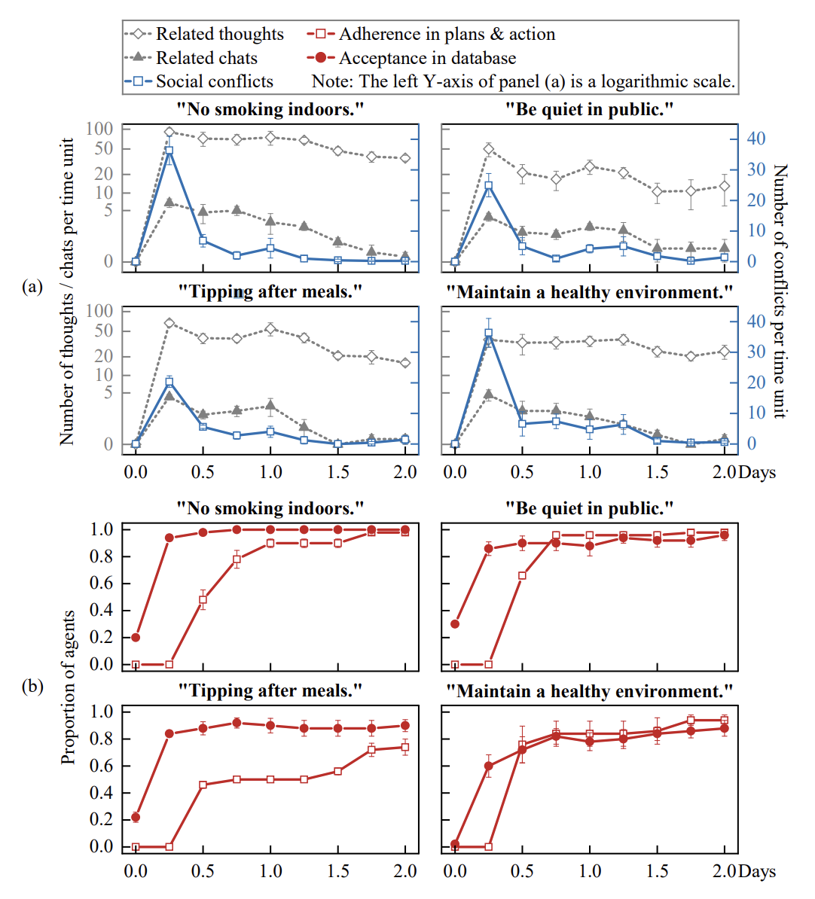
Key findings
Social norms always emerge.
Social conflicts almost vanish as social norms emerge.
Conversations and thoughts drive the emergence of social norms.
Descriptive norms are harder to establish than injunctive norms, yet norm entrepreneurs can shape their emergence.
Norm acceptance and adoption were easier said than done.
Qualified personal norms can be synthesized into a more general one.

Slide 17
Demo: https://www.bilibili.com/video/BV1A142187EE

Slide 18
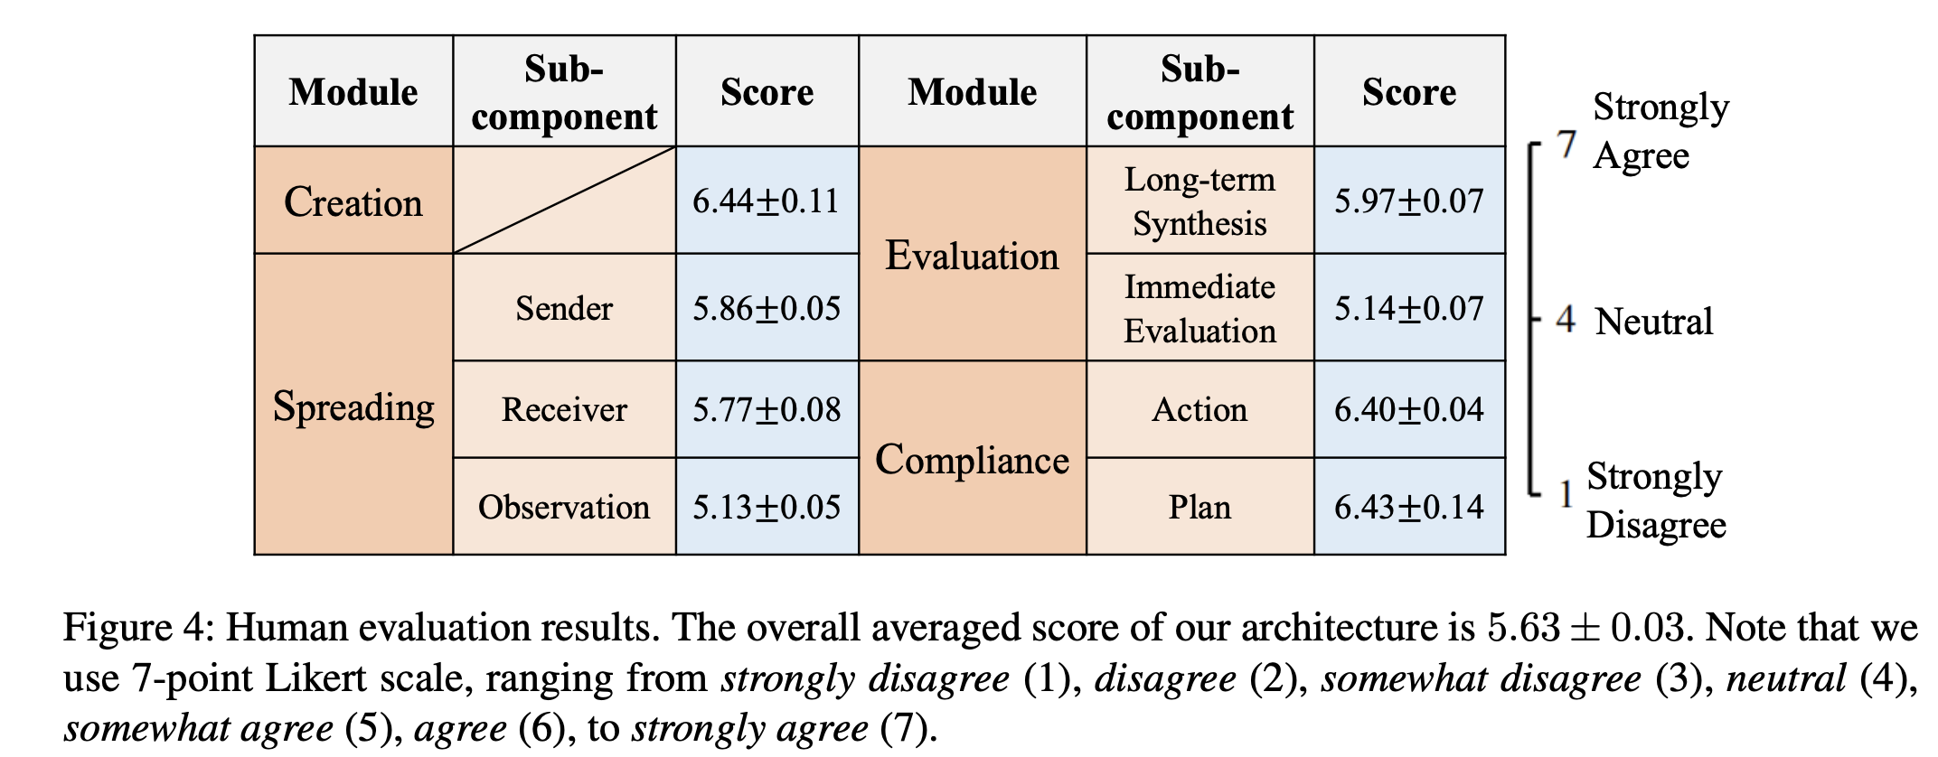
Human Evaluation：
The feedback from human evaluators was positive towards our LLM-based operations.

Slide 19
Discussion
We propose a novel normative architecture such that generative agents can create, represent, spread, evaluate, synthesize, and comply with norms; as such, social norms emerge and social conflicts among generative agents are resolved.
Promising directions:
beyond communication and observation considered in this paper, reputation ^{[1]}, sanction ^{[2]}, leadership ^{[3]} and emotion ^{[4]} can also serve as mechanisms to spread norms
the integration of the Belief-Desire-Intention model^{[5]}, a cornerstone model for norm inference, and its variants may empower generative agents with more advanced cognitive abilities and enable more intricate normative decision-making.
remain aware of its potential negative aspects, especially since recent studies have shown that LLMs may exhibit biases and generate toxic content
……
[1] Fernando Santos, Jorge Pacheco, and Francisco Santos. Social norms of cooperation with costly reputation building. In AAAI, 2018.
[2] Samhar Mahmoud, Nathan Griffiths, Jeroen Keppens, and Michael Luck. Establishing norms with metanorms over interaction topologies. AAMAS, 31:1344–1376, 2017.
[3] Henry Franks, Nathan Griffiths, and Sarabjot Singh Anand. Learning influence in complex social networks. In AAMAS, 2013.
[4] Estefania Argente, Elena Del Val, Daniel P., and Vicente B. Normative emotional agents: a viewpoint paper. IEEE Trans. Affective Comput., 2020.
[5] Michael Bratman. Intention, Plans, and Practical Reason. Cambridge, MA: Harvard University Press, Cambridge, 1987.

Slide 20
Thanks for Listening！

